Slide 1

Voice Assistant Credit Card Management Survey Results
Prepared for: Alliance Data Services
BusML 7201 - Market Research and Analysis
Jonathan Pryor
Avinash Minhas
Nicholas Brown
(Image Source: https://pixabay.com)

Slide 2
Objectives
Determine current consumer preferences in voice technology platforms
Investigate consumer likelihood to use voice assistant technology to manage credit card accounts in future functionality
Understand how credit card users feel about privacy issues relating to future use in managing card services through voice assistant technology
Concentrate research on likely early adopter or innovator consumers to understand their concerns and desires for voice command credit card management

Slide 3
Methodology
Study performed as a part of BusML 7201 - Market Research and Analysis lead by Professor Daniel Zantedeschi
Students designed an online survey which was distributed through Qualtrics from April 2 to April 10, 2018
Survey was distributed to likely tech savvy credit card users
To qualify for the survey consumers must have used a credit card in the last three months
The survey received 54 qualified responses
Data analysis performed in R with visualizations from R, Qualtrics and Tableau

Slide 4
Key Findings
Voice technology ecosystem findings:
Most consumers are now aware of the major voice assistant technology platforms
Platform use was divided between the major voice assistant ecosystems with Amazon’s Alexa and Apple’s Siri leading in consumer adoption and Microsoft’s Cortana and Google Assistant receiving less, but still significant, usage
83% of respondents had used voice technology within the previous year
Of voice technology users 93% had used the technology in the past month and over half had used the tech 10+ times in the previous month

Slide 5
Key Findings - Continued
Voice management of credit card account findings:
52% of respondents were interested or possibly interested in credit card management through voice technology platforms
There did not appear to be a relationship between the likelihood to adopt new technology and the likelihood to use voice assistant technology to manage credit card accounts
Demographics did not appear to be a contributing factor to interest in adopting card voice management
Respondents seemed to be most interested in the time savings and 24/7 availability benefits to voice card management
A major concern of respondents was that people with access to their voice management device would be able to access their credit card information

Slide 6
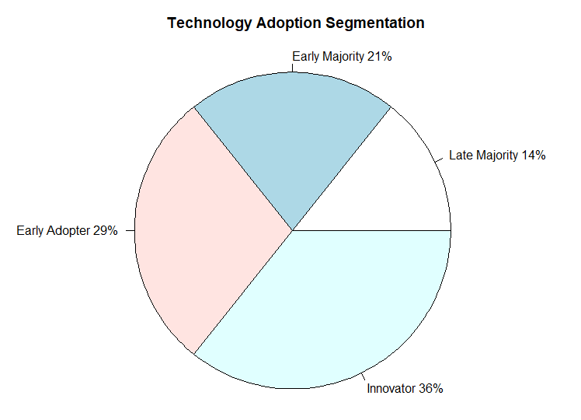
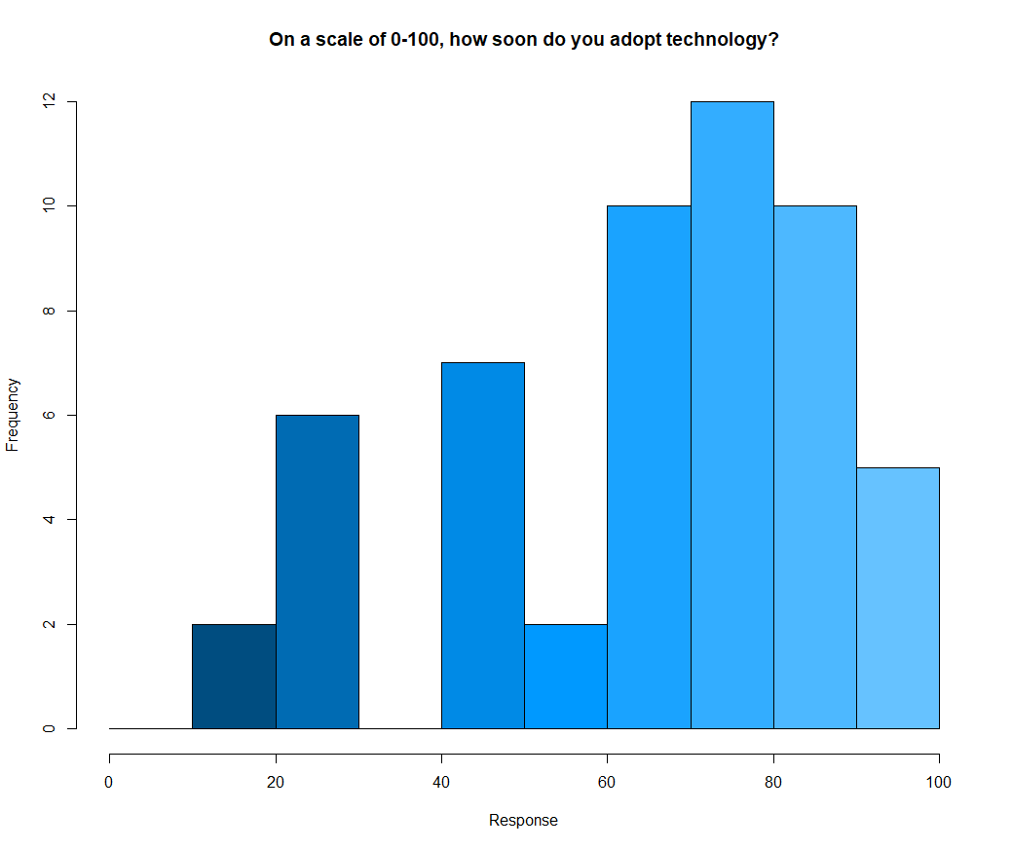
General Consumer Technology Adoption Attitudes
Most respondents felt that they were likely to adopt new technology, consistent with survey methodology
Over half of respondents were either categorized as innovators or early adopters

Slide 7
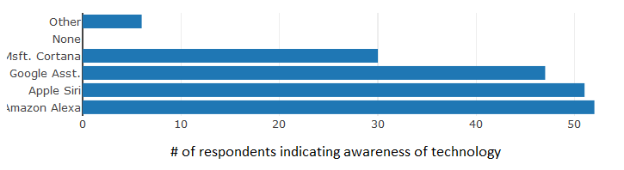
Familiarity with Voice Assistant Technology
Consumers were highly aware of Google Home, Apple Siri, and Amazon Alexa
All consumers were aware of at least one voice command technology

Slide 8
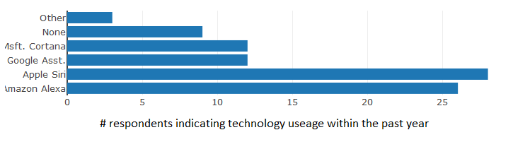
Voice Command Tech Platforms Used
Apple’s Siri and Amazon’s Alexa had significant leads in consumer use
Microsoft Cortana and Google Assistant/Home each boasted moderate usage

Slide 9
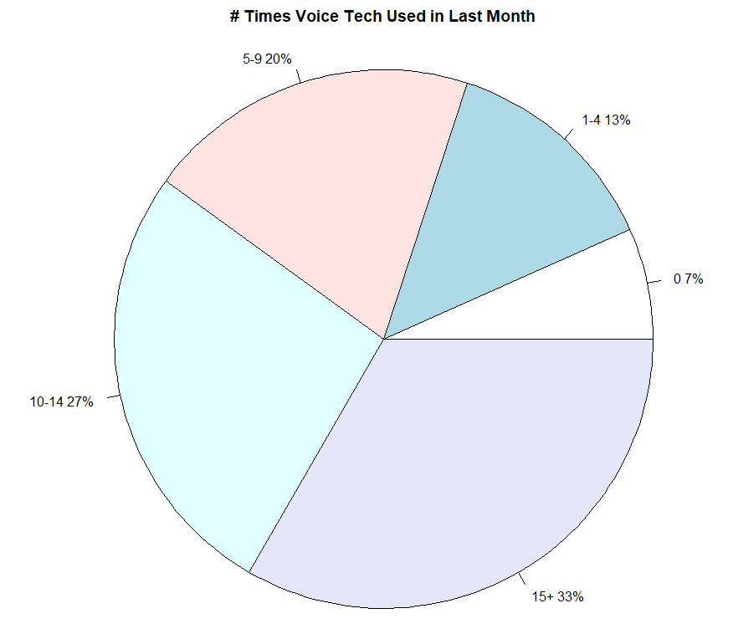
Voice Command Tech Usage Rates
Most respondents were regular and active users of voice assistant technologies
Of voice command users only 7% of respondents did not use voice technology in the previous month
A full third of respondents used voice technology 15+ times in the past month

Slide 10
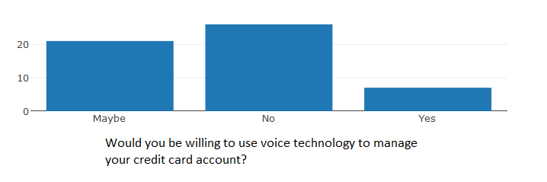
Likelihood to Use Voice Management of Card
Consumers seemed unsure of using voice technology to manage their credit accounts.
Only 13% said yes while 48% answered in the negative
The remainder of 39% were not sure
Consumer response guided consumers to indicate why or why they were not interested in using voice technology for credit account management

Slide 11
Factors in likelihood to use voice management
Respondents were asked to identify reasons they would be, or would not be, interested in using voice management on credit card accounts
Questions shown were based on the respondent’s self-indicated likelihood to use voice management on credit accounts
Respondents were then able to select one more more reasons they would like to indicate why or why they would not be interested in voice management

Slide 12
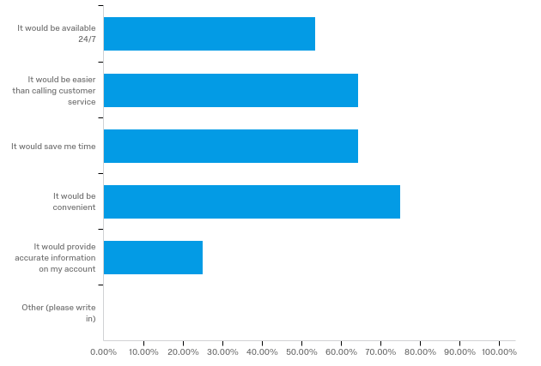
Reasons interested in voice management

Slide 13
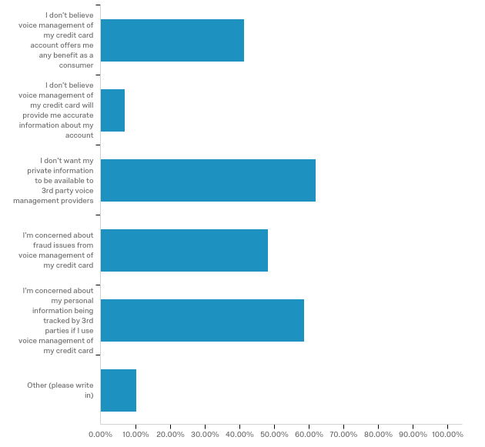
Reasons not interested in voice management

Slide 14
Statistical analysis
Multiple Linear Regression Modeling: An attempt at explaining the likelihood of using voice technology to manage credit card accounts as the dependent variable
All non-text survey questions (a.k.a. kitchen sink model) when input into a linear model resulted in a fairly impressive .89 R-squared measurement indicating much of the variation in likelihood to use rested in our data
However, adjusted R-squared was significantly lower at .71 which suggested many of the data fields did not have significant impact on the dependent variable
Most questions were not significant at either a 90% or 95% confidence level
There did not appear to be any demographic component to the likelihood to adopt card voice management

Slide 15
Statistical analysis - continued
A more simplified model does have some predictive value:
Likelihood to use in Future = 2.32 - .39(Q11_1) - .17(Q11_2) - .46(Q11_3) - .26(Q11_4) - .28(Q11_5) + .13(Q14)
Scale: Likely = 1, Maybe = 2, No = 3
Adjusted R-squared = .70
Note: Only Q14 and Q11_3 are significant at 95% level and Q11_1 is significant at the 90% level
The remaining Q11 responses were included in the model to help show which benefits had predictive value
Q11_1 (0 or 1) | Voice management service would be available 24/7
Q11_2 (0 or 1) | Voice management service would be easier than calling customer service
Q11_3 (0 or 1) | Voice management service would save me time
Q11_4 (0 or 1) | Voice management service would be convenient
Q11_5 (0 or 1) | Voice management service would provide accurate information
Q14 (1-5) | I am concerned about others using my device to access my information.

Slide 16
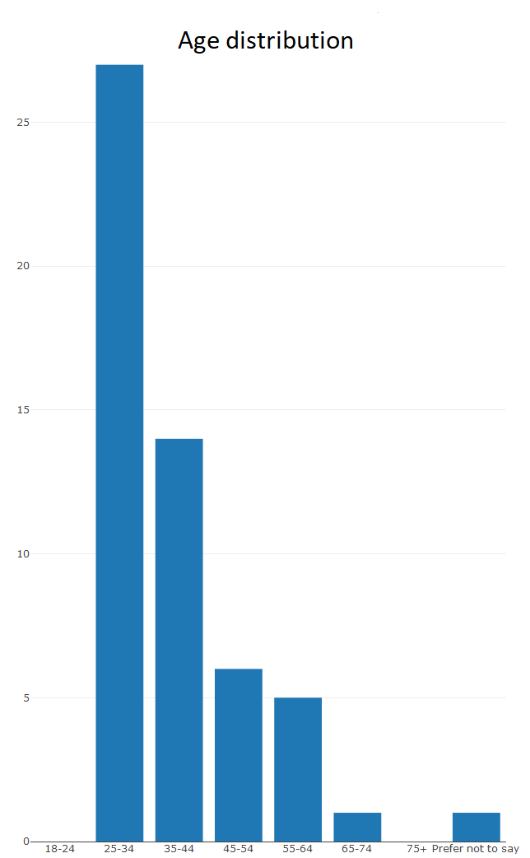
Demographics
# | Answer | % | Count
1 | Male | 33.93% | 19
2 | Female | 66.07% | 37
3 | Non-binary | 0.00% | 0
4 | Prefer not to say | 0.00% | 0
5 | Other | 0.00% | 0
 | Total | 100% | 56

Slide 17
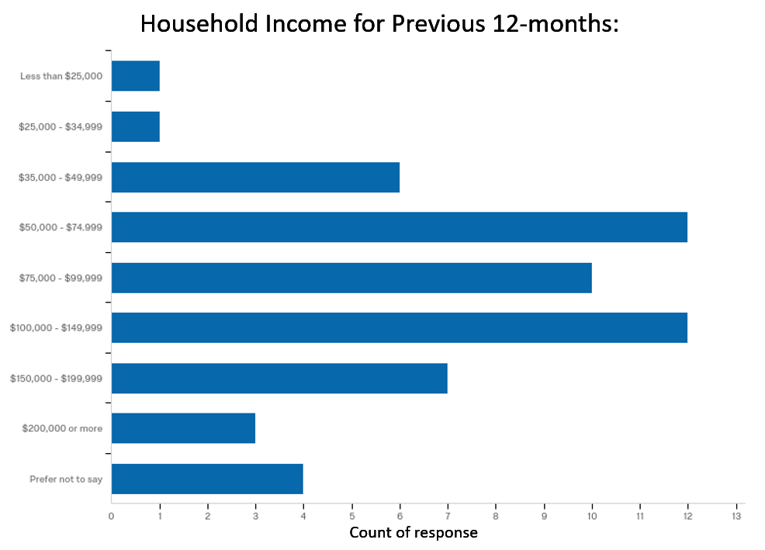
Demographics - continued

Slide 18
Other Information Needed
In a follow-up study the team would like to have the resources to be able to more widely distribute the survey to a more diverse set of respondents
Survey participants were a somewhat homogeneous group consisting of those that tend to be employed and have above-average household income
Females outnumbered males at a two to one rate
While the older millennial generation was covered there were no responses in the 18-24 age demographic
The team would like to gather data in a later study to investigate any relationship between other card features and interest in voice command card management
This study investigated consumer attitudes on voice card management only

Slide 19
Appendix
For additional information please see provided files:
Survey: VCTCCSurveyFinal.docx
R Scripting: ProjectRScript.R
R Output File: ProjectRScriptOUTPUT.txt
Image source: https://pixabay.com/en/speech-icon-voice-talking-audio-2797263/

